Slide 1
Deep Learning 101: from SSM to Mamba
Department of Industrial Engineering, Seoul National University
Yoo-Min Jung,
pamela7384@gmail.com
Doehyeon Lee
anthony16@snu.ac.kr

Slide 2
Table of Contents
Introduction
State Space Model (SSM)
SSMs Before Mamba
Mamba Structure
Applications
Conclusion

Slide 3
1. Introduction

Slide 4
Audience and Scope
1. Introduction
  Anyone who has studied CNN and RNN before
  Background and core ideas behind Mamba
  Without prior knowledge of Transformers
WHO
WHAT
WHY

Slide 5
Recap : CNN and RNN
1. Introduction
CNN – convolution filter
input
output
0
0
0
3
3
4
0
0
0
filter
0
0
1
1
1
2
4
0
0
−3
1
−3
−9
−3
14
−14
0
1
1
1
1
2
4
6
0
−1
−1
−1
1
1
−1
−5
−5
5
22
3
1
1
1
2
3
4
6
8
−5
−3
−5
−1
−1
−5
6
−1
8
−1
−5
0
−3
0
0
−3
3
3
2
2
2
3
4
5
7
8
5
3
3
3
4
5
6
8
8
−1
−1
−1
−1
−3
−5
−2
−2
−4
14
0
5
5
5
5
7
8
8
0
17
7
−2
−7
4
14
26
0
0
7
7
8
8
8
0
0
−17
26
10
8
12
25
−24
0
0
0
8
8
8
0
0
0

Slide 6
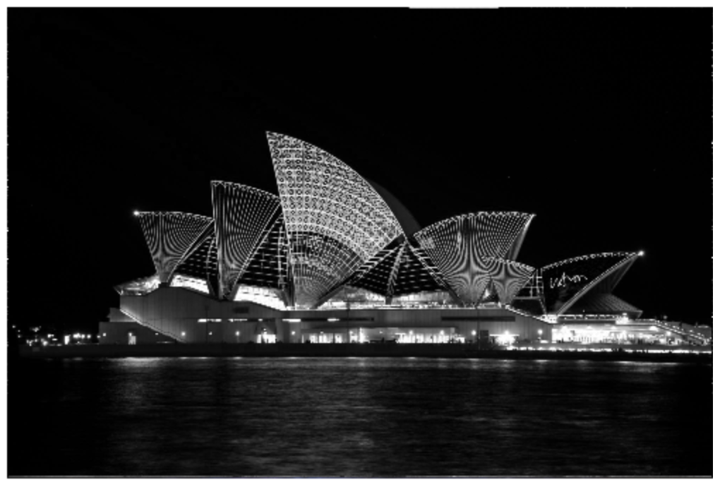
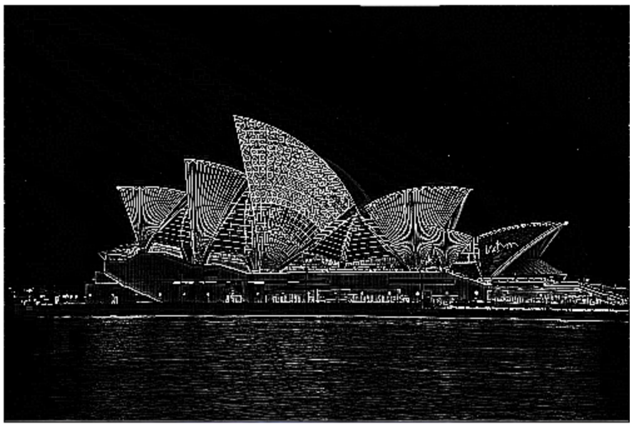
Recap : CNN and RNN
1. Introduction
CNN – convolution filter
input
output
filter
−1
−1
−1
−1
8
−1
−1
−1
−1
[screenshot] Victor Powell - Image Kernels explained visually. Accessed: 2026-09-04.

Slide 7
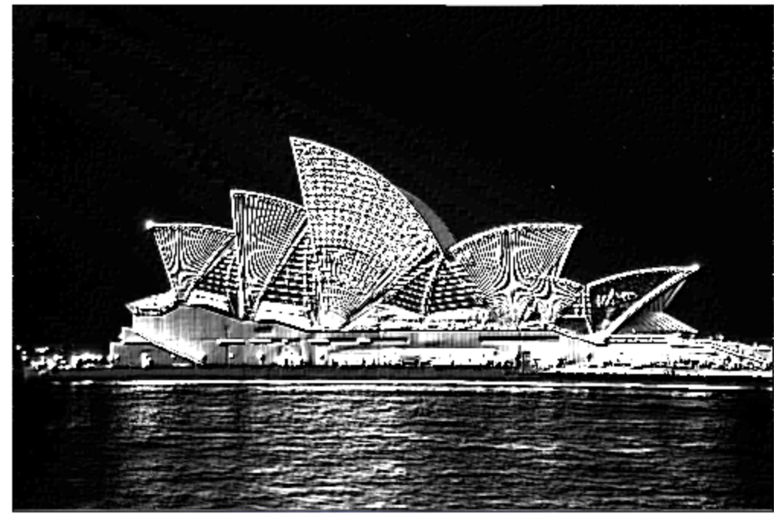
Recap : CNN and RNN
1. Introduction
CNN – convolution filter
input
output
filter
?
[screenshot] Victor Powell - Image Kernels explained visually. Accessed: 2026-09-04.

Slide 8

Recap : CNN and RNN
1. Introduction
CNN – skip connection (residual connection)
  if $ℋ\left(x\right)=x+ℱ\left(x\right)$, $ℱ$ only has to learn the residual, $ℋ\left(x\right) – x$.
[figure] He, K., Zhang, X., Ren, S., & Sun, J. (2016). Deep residual learning for image recognition. In CVPR.

Slide 9
Recap : CNN and RNN
1. Introduction
RNN – backpropagation through time ^{(BPTT)}
Loss
backward
tanh
forward

Slide 10
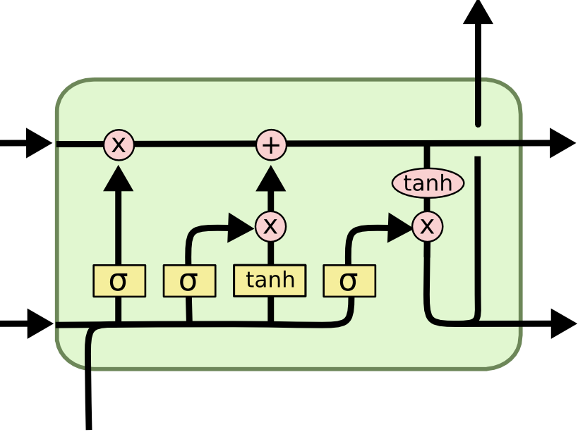
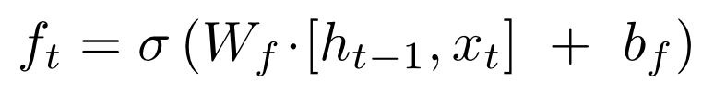
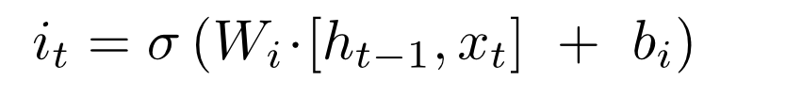
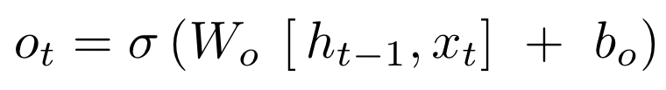

Recap : CNN and RNN
1. Introduction
RNN – gating mechanism
  control how much of a given result is output externally ($∈\left[0,1\right]$)
forget
input
output
[figure] Understanding LSTM Networks -- colah's blog. Accessed: 2026-09-04.

Slide 11
2. State Space Model (SSM)

Slide 12
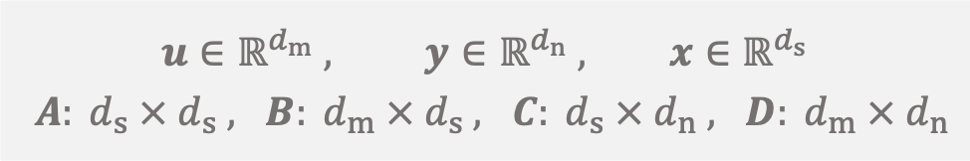
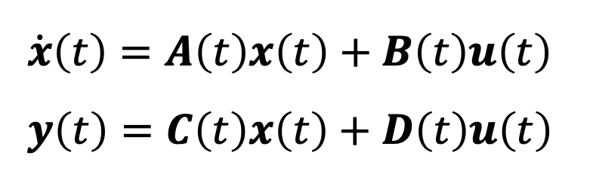
Continuous-Time SSM
2. State Space Model (SSM)
SSM
  “ a mathematical model of a physical system that uses state variables
  to track how inputs shape system behavior over time through
  first-order differential equations or difference equations. ” _{– Wikipedia}
= hidden state
y
$\dot{x}\left(t\right)=A\left(t\right)x\left(t\right)+B\left(t\right)u\left(t\right)$
$y\left(t\right)=C\left(t\right)x\left(t\right)+D\left(t\right)u\left(t\right)$
C
D
∫
A
B
$$u∈ℝ^{d_{m}} , y∈ℝ^{d_{n}} , x∈ℝ^{d_{s}}$$
$A: d_{s} × d_{s} , B: d_{m} × d_{s} , C: d_{s} × d_{n} , D: d_{m} × d_{n}$
u

Slide 13
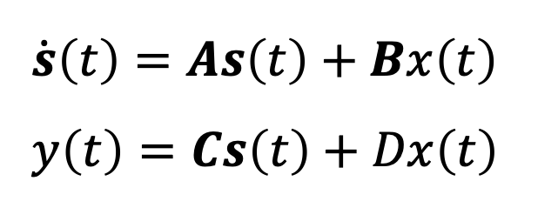
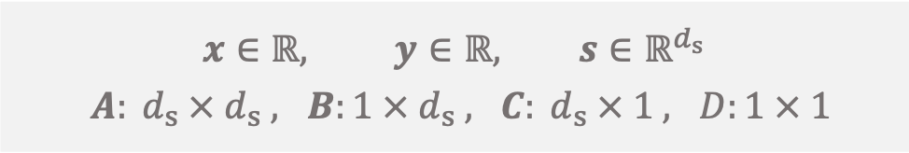
Continuous-Time SSM
2. State Space Model (SSM)
SSM in deep learning
  Single-Input Single-Output ^{(SISO)}, Linear Time-Invariant ^{(LTI)} System
y
$\dot{s}\left(t\right)=As\left(t\right)+Bx\left(t\right)$
$y\left(t\right)=Cs\left(t\right)+Dx\left(t\right)$
C
D
∫
A
B
$$x∈ℝ, y∈ℝ, s∈ℝ^{d_{s}}$$
$A: d_{s} × d_{s} , B:1 × d_{s} , C: d_{s} × 1 , D:1 × 1$
u

Slide 14

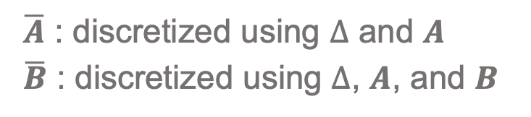
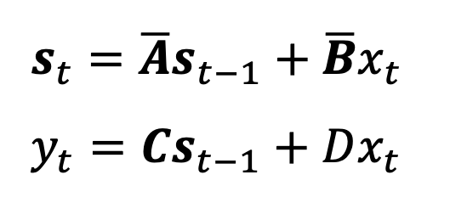
Discrete-Time SSM
2. State Space Model (SSM)
SSM in deep learning
  give fixed step $Δ>0$,
y
$s_{t}=\overline{A}s_{t−1}+\overline{B}x_{t}$
$y_{t}=Cs_{t−1}+Dx_{t}$
C
D
∫
A
B
$\overline{A}$ : discretized using $Δ$ and $A$
$\overline{B}$ : discretized using $Δ$, $A$, and $B$
u

Slide 15
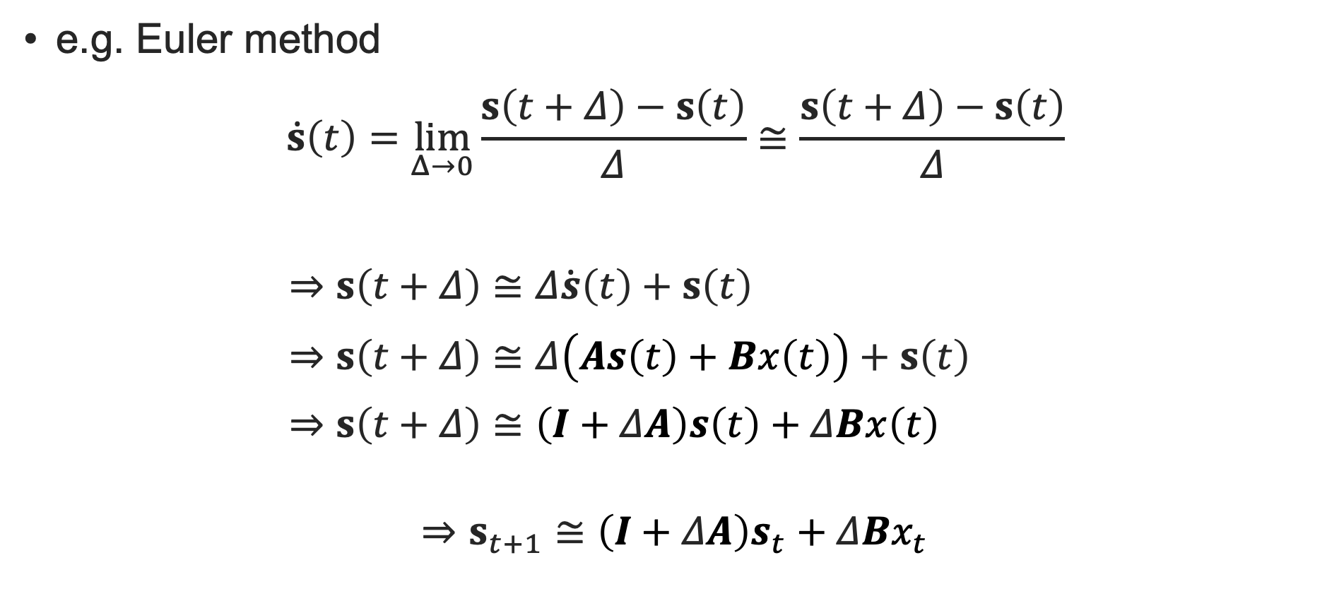


Discrete-Time SSM
2. State Space Model (SSM)
e.g. Euler method
$$\dot{s}\left(t\right)=\lim_{Δ→0}{\frac{s\left(t+Δ\right)−s\left(t\right)}{Δ}}≅\frac{s\left(t+Δ\right)−s\left(t\right)}{Δ}$$
$⇒s\left(t+Δ\right)≅Δ\dot{s}\left(t\right)+s\left(t\right)$
$⇒s\left(t+Δ\right)≅Δ\left(As\left(t\right)+Bx\left(t\right)\right)+s\left(t\right)$
$⇒s\left(t+Δ\right)≅\left(I+ΔA\right)s\left(t\right)+ΔBx\left(t\right)$
$$⇒s_{t+1}≅\left(I+ΔA\right)s_{t}+ΔBx_{t}$$
$$\overline{A}$$
$$\overline{B}$$

Slide 16

Discrete-Time SSM
2. State Space Model (SSM)
SSM for multivariate data
  SISO → Channel Independent
y
$s_{t}=\overline{A}s_{t−1}+\overline{B}x_{t}$
$y_{t}=Cs_{t−1}+Dx_{t}$
C
D
∫
A
$$× M$$
B
$\overline{A}$ : discretized using $Δ$ and $A$
$\overline{B}$ : discretized using $Δ$, $A$, and $B$
u

Slide 17
3. SSMs Before Mamba

Slide 18
Predecessors to Mamba
3. SSMs Before Mamba
HiPPO (NeurIPS 2020)
LSSL (2021)
S4 (2022), S4D (2022)
H3 (2023)
HiPPO
LSSL
S4(D)
H3
SSM
Mamba

Slide 19




HiPPO ^{[Gu et al.’20]}
3. SSMs Before Mamba
not a deep learning model, not formulated in SSM terminology
propose a fixed value of $A$, using polynomial bases
  to contain as much context as possible within a given memory ^{(state space)}
HiPPO
LSSL
S4(D)
H3
SSM
Mamba
1
0
0
0
0
0
1
√3
2
0
0
0
0
√3
$$d_{s}=6$$
√5
√15
3
0
0
0
√5
√7
√21
√35
4
0
0
√7
3
3√3
3√5
3√7
5
0
3
√11
√33
√55
√77
3√11
6
√11
$$A$$
$$B$$
[equation] Gu et al. (2020). HiPPO: Recurrent memory with optimal polynomial projections. NeurIPS.

Slide 20
LSSL ^{[Gu et al.’21]}
3. SSMs Before Mamba
HiPPO
LSSL
S4(D)
H3
SSM
Mamba
inference like RNN, training like CNN
[figure] Gu et al. (2021). Combining recurrent, convolutional, and continuous-time models with linear state space layer. NeurIPS.

Slide 21





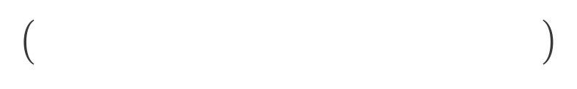




















































































LSSL ^{[Gu et al.’21]}
3. SSMs Before Mamba
HiPPO
LSSL
S4(D)
H3
SSM
Mamba
inference like RNN, training like CNN = parallelizable training
$h_{1}=$
$$y_{1}$$
$$y_{2}$$
$$y_{3}$$
$$y_{4}$$
$$\overline{B}$$
$x_{1}$
$$y_{1}$$
$$y_{2}$$
$$y_{3}$$
$$y_{4}$$
$h_{2}=$
$$\overline{B}$$
$$\overline{A}$$
$h_{1}+$
$$\overline{B}$$
$$\overline{A}$$
$x_{1}+$
$x_{2}=$
$$\overline{B}$$
$x_{2}$
$$C$$
$$C$$
$$C$$
$$C$$
$h_{3}=$
$$\overline{A}$$
$$\overline{B}$$
$$\overline{A}$$
$$\overline{B}$$
$x_{2}+$
$$\overline{A}$$
$h_{2}+$
$$\overline{B}$$
$$\overline{A}$$
$x_{1}+$
$$\overline{B}$$
$x_{3}$
$$h_{1}$$
$$\overline{A}$$
$$h_{2}$$
$$\overline{A}$$
$$h_{3}$$
$$\overline{A}$$
$$h_{4}$$
$$\overline{A}$$
$x_{3}=$
$$⋯$$
$$\overline{B}$$
$$\overline{B}$$
$$\overline{B}$$
$$\overline{B}$$
$h_{t}=$
$$\overline{A}$$
$$^{t−1}$$
$$\overline{B}$$
$x_{1}+⋯+$
$$\overline{A}$$
$$\overline{B}$$
$x_{t−1}+$
$$\overline{A}$$
$h_{t−1}+$
$$\overline{B}$$
$x_{t}=$
$$\overline{B}$$
$x_{t}$
$$x_{1}$$
$$x_{2}$$
$$x_{3}$$
$$x_{4}$$
$$x_{1}$$
$$x_{2}$$
$$x_{3}$$
$$x_{4}$$
$y_{t}=$
$$\overline{A}$$
$$^{t−1}$$
$$\overline{B}$$
$x_{1}+⋯+$
$$\overline{A}$$
$$\overline{B}$$
$x_{t−1}+$
$$\overline{B}$$
$x_{t}$
$$C$$
$h_{t}=$
$$C$$
$$D$$
$+ x_{t}$

Slide 22
























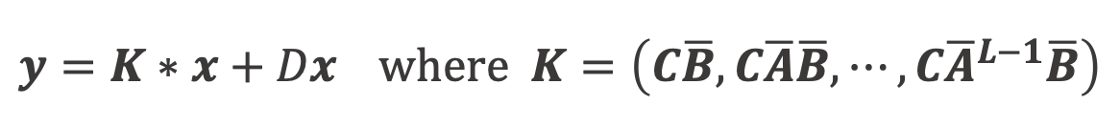























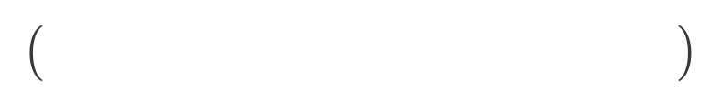




LSSL ^{[Gu et al.’21]}
3. SSMs Before Mamba
inference like RNN, training like CNN = parallelizable training
HiPPO
LSSL
S4(D)
H3
SSM
Mamba
⋮
$$C$$
$$\overline{A}$$
$^{L−1}$
$$\overline{B}$$
$$C$$
$$\overline{A}$$
$^{L−2}$
$$\overline{B}$$
$h_{t}=$
$$\overline{A}$$
$$^{t−1}$$
$$\overline{B}$$
$x_{1}+⋯+$
$$\overline{A}$$
$$\overline{B}$$
$x_{t−1}+$
$$\overline{B}$$
$x_{t}$
$$\overline{A}$$
$h_{t−1}+$
$$\overline{B}$$
$x_{t}=$
$$x$$
$y_{t}=$
$$\overline{A}$$
$$^{t−1}$$
$$\overline{B}$$
$x_{1}+⋯+$
$$\overline{A}$$
$$\overline{B}$$
$x_{t−1}+$
$$\overline{B}$$
$x_{t}$
$$C$$
$h_{t}=$
$$C$$
$$C$$
$$\overline{A}$$
$^{2}$
$$x_{1}$$
$$x_{2}$$
$$x_{3}$$
⋮
$$x_{L−1}$$
$$x_{L}$$
$$\overline{B}$$
$$D$$
$$∗$$
$$+ Dx_{3}=y_{3}$$
$+ x_{t}$
$$C$$
$$\overline{A}$$
$$\overline{B}$$
$$C$$
$$\overline{B}$$
$$K$$
$$y=K∗x+Dx where K=\left(C\overline{B},C\overline{A}\overline{B},⋯,C{\overline{A}}^{L−1}\overline{B}\right)$$

Slide 23

S4 ^{[Gu et al.’22]} & S4D ^{[Gu et al.’22]}
3. SSMs Before Mamba
HiPPO
LSSL
S4(D)
H3
SSM
Mamba
reduce the representation of $A$ from $O\left(d_{s}^{2}\right)$ to $O\left(d_{s}\right)$
  S4 : reparameterize $A$ as diagonal + low-rank
    $A′=Λ−PQ^{∗}$
    derived with HiPPO matrix
  S4D : use diagonal matrix for $A$
    much simpler
[figure] Gu et al. (2022). On the parameterization and initialization of diagonal state space model. NeurIPS.

Slide 24

H3 ^{[Fu et al.’23]}
3. SSMs Before Mamba
HiPPO
LSSL
S4(D)
H3
SSM
Mamba
SSM with shift
  use shift matrix $A$ that shift each coordinate down by one
  “ thereby creating a “memory” of the previous states. ”
[equation, figure] Fu et al. (2023). Hungry Hungry Hippos: Towards Language Modeling with State Space Models. ICLR.

Slide 25
4. Mamba Structure

Slide 26



TL;DR
4. Mamba Structure
Mamba = Selective SSM + Gated Linear Unit
SSM
Linear
A
Δ
B
C
D
Selective SSM
$$σ$$
Linear
Linear
$$σ$$
Conv1D

Slide 27

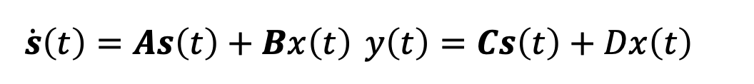
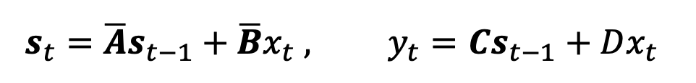
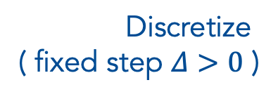
Selective SSM + Gated Linear Unit
4. Mamba Structure
$s\left(t\right)$ : state vector, $x\left(t\right),y\left(t\right)$ : input/output scalar
Characteristics
  LTI ^{(Linear Time-Invariant)}
  Channel Independent
SSM ^{[Recap]}
SSM
$\dot{s}\left(t\right)=As\left(t\right)+Bx\left(t\right)$ $y\left(t\right)=Cs\left(t\right)+Dx\left(t\right)$
A
Δ
B
C
D
$s_{t}=\overline{A}s_{t−1}+\overline{B}x_{t} ,$ $y_{t}=Cs_{t−1}+Dx_{t}$
Discretize
( fixed step $Δ>0$ )
$$σ$$
Conv1D

Slide 28
Selective SSM + Gated Linear Unit
4. Mamba Structure
Real world is not an LTI system
Choose two tasks that original SSM might not work well
  selective copying ^{(proposed)}, induction heads ^{[Olsson et al.’22]}
[figure] Gu and Dao (2024). Mamba: Linear-time sequence modeling with selective state spaces. COLM.

Slide 29
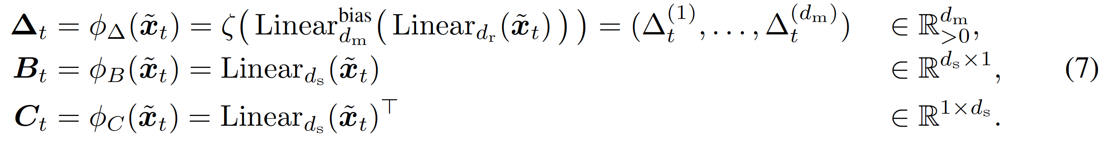

Selective SSM + Gated Linear Unit
4. Mamba Structure
${\tilde{x}}_{t}$ : given input at time $t$ → $Δ_{t}, B_{t}, C_{t}$
Characteristics
  Time-Varying ^{(TV)}, Channel Mixed
  $A$ is diagonal matrix
Selective Mechanism
SSM
A
Δ
B
C
D
$$σ$$
Conv1D

Slide 30
Selective SSM + Gated Linear Unit
4. Mamba Structure
Gated Linear Unit (Gated MLP)
SSM
Linear
A
Δ
B
C
D
Selective SSM
$$σ$$
Linear
Linear
$$σ$$
Conv1D

Slide 31

Selective SSM + Gated Linear Unit
4. Mamba Structure
Why not this ↴
SSM
Linear
A
Δ
B
C
D
Selective SSM
$$σ$$
$$σ$$
Conv1D
Linear
Linear

Slide 32
Selective SSM + Gated Linear Unit
4. Mamba Structure
Original figure
[figure] Gu and Dao (2024). Mamba: Linear-time sequence modeling with selective state spaces. COLM.

Slide 33

Selective SSM + Gated Linear Unit
4. Mamba Structure
= 1 Mamba block
SSM
Linear
A
Δ
B
C
Selective SSM
Mamba
$$σ$$
Linear
Linear
$$σ$$
Conv1D

Slide 34
Experimental Results
4. Mamba Structure
selective copying & induction heads
[table, figure] Gu and Dao (2024). Mamba: Linear-time sequence modeling with selective state spaces. COLM.

Slide 35
more details …
4. Mamba Structure
“selective scan”
  various techniques to make memory and computation efficient
  ➔ see other educational materials (e.g. here)
various experimental results
  ➔ see paper

Slide 36
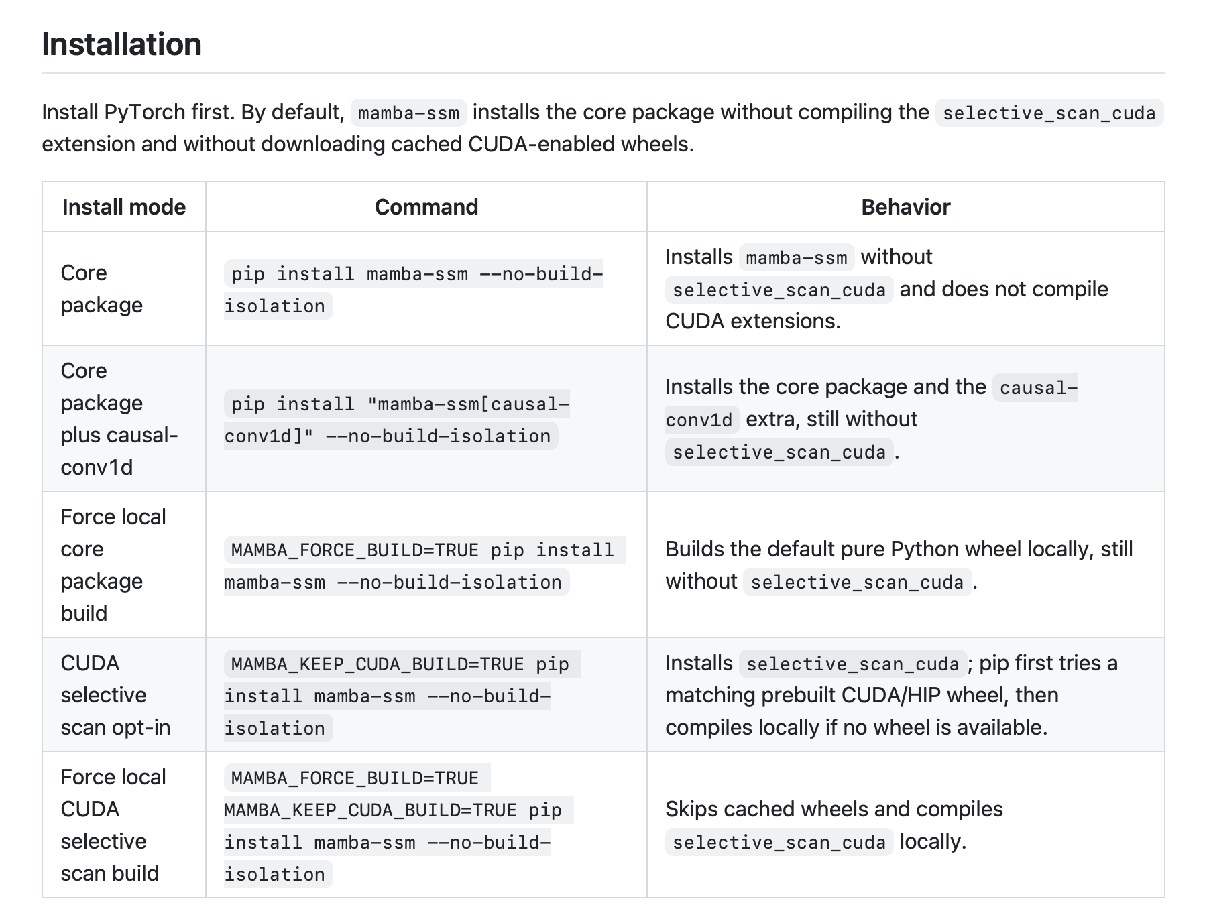
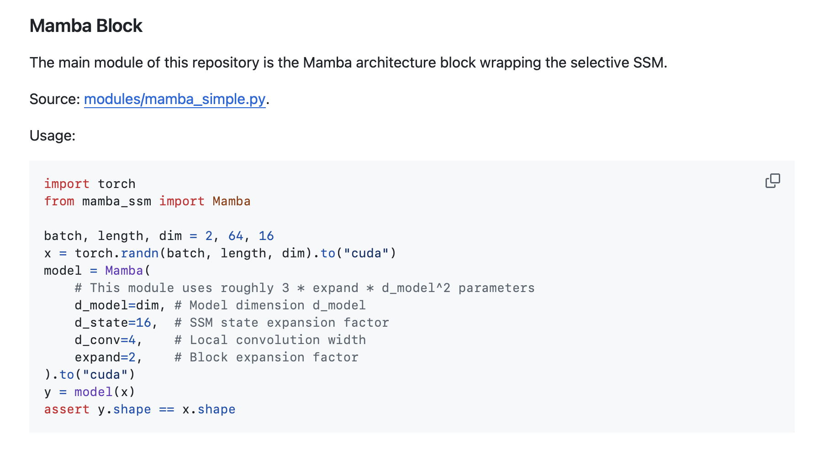
Implementation in PyTorch
5. Applications
No need to implement by yourself !
Use official mamba-ssm library !!
[screenshot] GitHub - state-spaces/mamba: Mamba SSM architecture. Accessed: 2026-09-04.

Slide 37
5. Applications

Slide 38
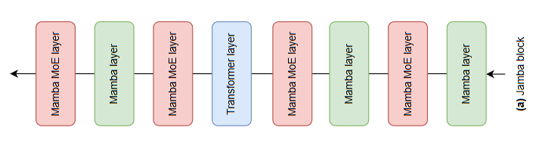
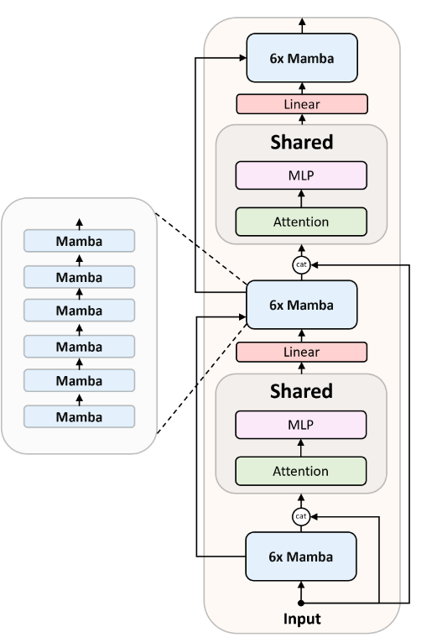
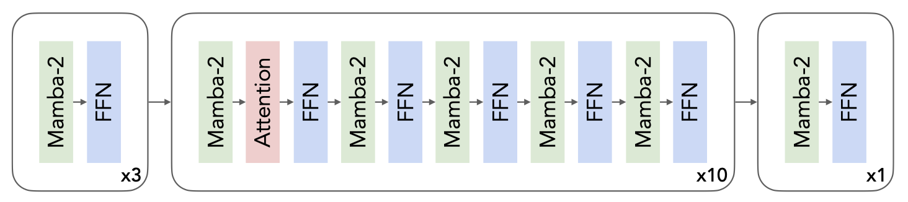
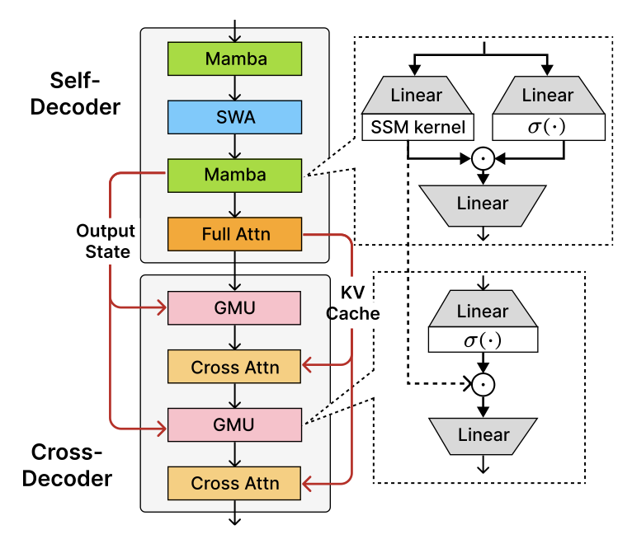
in Language
5. Applications
Mamba-Transformers hybrid structure
  Jamba ^{(AI21 Labs’24)}, Zamba ^{(Zyphra’24)}, Nemotron-H ^{(NVIDIA’25)}
  Hunyuan-TurboS ^{(Tencent’25, closed)}, Phi4-mini-Flash-Reasoning ^{(Microsoft’25)}
[figures] Lieber et al. (2024) Jamba, Glorioso et al. (2024) Zamba, Blakeman et al. (2025), Nemotron-H, Ren et al. (2025), Phi4-mini-Flash

Slide 39
in Vision
5. Applications
various scanning methods
  VisionMamba^{[Zhu et al.’24]}
  VMamba^{[Liu et al.’24]}
[figure] Qu et al. (2026). A survey of Mamba. ACM Transactions on Intelligent Systems and Technology.

Slide 40
in Time Series
5. Applications
channel-axis vs. time-axis
  in channel-axis : S-Mamba^{[Wang et al.’25]}
  in time-axis : Affirm^{[Wu et al.’25]}
  both available : TimeMachine^{[Ahamed and Cheng’24]}, Bi-Mamba+^{[Liang et al.’24]}
usually bidirectional
sometime mixed

Slide 41
6. Conclusion

Slide 42
Wrap-Up
6. Conclusion
from SSM to Mamba
1. SSM
2. HiPPO
3. LSSL
4. S4(D)
5. H3
6. Mamba
SSM equation
LTI & channel independent
fixed A
parallelizable training
diagonalized/diagonal A
SSM with shift
selective mechanism
applications

Slide 43
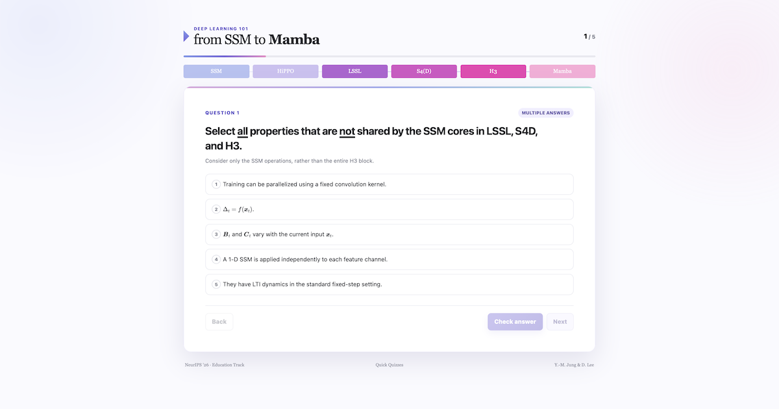
Quick Quizzes
6. Conclusion
5 quizzes (NeurIPS'26 - Mamba101 quick quizzes.html)

Slide 44
Thank you
Deep Learning 101 : from SSM to Mamba
Y.-M. Jung & D. Lee

